Slide 1

SECURITY SOLUTIONS
Bravo Security Services
Experience the future of security: ANPR redefined

Slide 2
In the realm where technology meets vigilance, ANPR paints security with precision's elegance
"In today's fast-paced world, efficient traffic management and security are paramount. Our Automatic Number Plate Recognition (ANPR) project leverages cutting-edge technology to enhance surveillance, streamline operations, and ensure safety with precision and speed.
Automatic Number Plate Recognition (ANPR) systems enhance security by swiftly identifying vehicles, aiding in crime prevention and ensuring controlled access with accurate monitoring capabilities.
Introduction

Slide 3
Problem Statement
Inefficient Vehicle Entry Management: A Bottleneck to Productivity and Security
The manual recording of vehicle entry and exit at our company's gates has become a significant pain point, resulting in substantial time wastage, data inaccuracies, and congestion. The current process relies heavily on security guards to manually log vehicle details, leading to:
Delays and queues at the gate, causing frustration among employees and visitors
Inefficient use of security personnel's time, diverting them from more critical tasks
Inaccurate and incomplete data, making it challenging to track vehicle movements and maintain a reliable record
Significant expenditure on salaries, paper, and other administrative resources
This inefficient system not only hampers productivity but also projects a negative image of our organization. To address this challenge, we propose the development of an Automated Number Plate Recognition (ANPR) system that can accurately capture and record vehicle number plates in real-time, eliminating manual errors and streamlining the entry process.

Slide 4
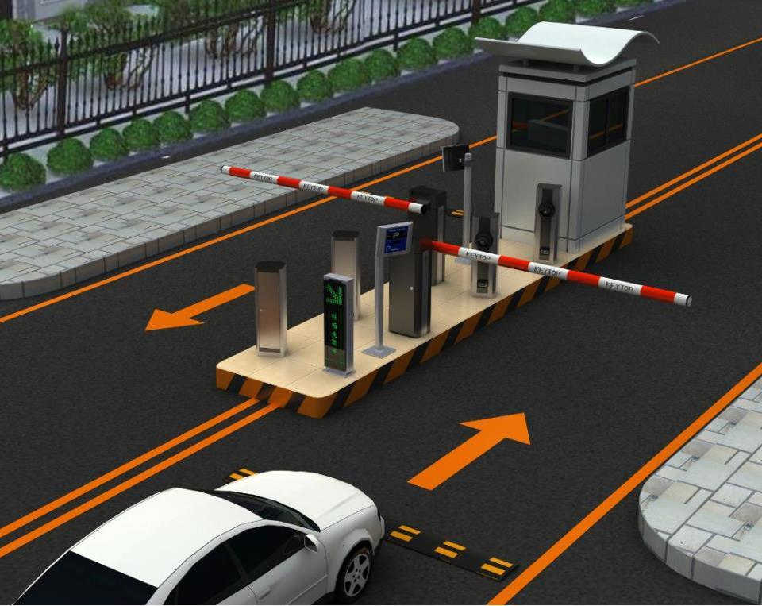
What is ANPR ?
ANPR, or Automatic Number Plate Recognition, is a technology that uses optical character recognition (OCR) to automatically read vehicle registration plates. It employs cameras and specialized software to capture images of vehicles, extract their number plates, and convert the alphanumeric characters into readable text. ANPR systems are widely used in traffic management, law enforcement, toll collection, parking management, and security applications. They enhance efficiency by automating the process of vehicle identification and monitoring, thereby improving safety and operational effectiveness in various contexts.

Slide 5
Traffic Management: ANPR helps in monitoring and managing traffic flow by identifying vehicles, tracking their movements, and collecting data on traffic patterns.
Law Enforcement: Police and law enforcement agencies use ANPR to detect and track vehicles involved in criminal activities, monitor traffic violations, and enforce parking regulations.
Toll Collection: ANPR facilitates automatic toll collection on highways and bridges by identifying vehicles and charging toll fees without the need for manual intervention.
Parking Management: ANPR systems automate parking facilities by identifying vehicles entering and exiting parking lots, managing parking occupancy, and facilitating payment systems.
Border Control and Immigration: ANPR assists in border control by monitoring vehicle crossings, verifying vehicle registrations, and enhancing security at border checkpoints.
Vehicle Access Control: ANPR is used in gated communities, corporate campuses, and secure facilities to control vehicle access based on registered number plates.
Security Surveillance: ANPR enhances security surveillance by monitoring vehicles in sensitive areas, identifying suspicious vehicles, and aiding in crime prevention.
Public Safety: ANPR supports public safety initiatives by assisting in Amber Alerts, locating stolen vehicles, and identifying vehicles associated with emergencies.
Environmental Monitoring: ANPR can contribute to environmental initiatives by monitoring vehicle emissions and enforcing regulations related to vehicle emissions in restricted areas.
Smart City Initiatives: ANPR is integral to smart city projects by providing data for urban planning, traffic optimization, and enhancing overall city infrastructure.
Where ANPR can be used ?

Slide 6
Technologies used to develop Application
Frontend
Backend
Object Detection
Optical Character Recognition:
Database
React, Tailwind CSS
Backend: Python, Streamlit
MongoDB
YOLOv8
EasyOCR and Tesseract OCR

Slide 7

Why to use ANPR ?
Enhanced Security: Enables real-time vehicle tracking and identification for enhanced surveillance and crime prevention.
Efficient Traffic Management: Facilitates traffic flow monitoring and congestion management, optimizing urban mobility.
Seamless Toll Collection: Automates toll payment processes, reducing queues and improving user convenience.
Effective Law Enforcement: Assists in enforcing traffic regulations, managing parking violations, and identifying vehicles involved in crimes.
Operational Efficiency: Automates access control, parking management, and border crossings, reducing manual workload.
Data-driven Insights: Provides valuable data for traffic analytics, urban planning, and policy-making.
Accuracy and Reliability: Minimizes human error in vehicle identification and data collection.
Supports Environmental Goals: Helps enforce emissions regulations and supports initiatives for sustainable urban development.
Integration with Smart City Initiatives: Contributes to smart city infrastructure for comprehensive urban management.
BRAVO
SECURITY SERVICES

Slide 8

Work Flow
Image Acquisition
Object Detection
(YOLOv8)
Character Recoginition
Data Storage and Management
(MongoDB)
UI
"INTEGRATED WORKFLOW OF AUTOMATIC NUMBER PLATE RECOGNITION (ANPR) SYSTEM WITH OBJECT DETECTION AND CHARACTER RECOGNITION"

Slide 9
How Live mode
works ?

Slide 10

How Live mode
works ?
Camera Activation
Real-time Image Processing
Number Plate Recognition
Data Storage
The ANPR system initiates by activating the live camera feed, capturing real-time images of vehicles entering its field of view.
The recognized number plate data, along with relevant metadata such as timestamps and confidence scores, is promptly stored in a MongoDB database. This enables efficient data management and retrieval for further analysis and operational use.
Each captured image undergoes immediate processing by the YOLOv8 object detection model. YOLOv8 analyzes the image in a single pass, swiftly identifying and localizing vehicle number plates within the scene.
Once a number plate is localized, the system extracts and decodes the alphanumeric characters using EasyOCR. This OCR process utilizes deep learning models to ensure accurate and reliable character recognition.

Slide 11
How Camera mode
works ?

Slide 12
How Camera mode
works ?
Image Capture
Image Processing
Character Recognition
Data Storage
The Camera Mode allows users to capture snapshots of vehicles using a camera connected to the ANPR system. Users initiate the capture process manually through the system's user interface.
Once a snapshot is taken, the ANPR system processes the captured image using the YOLOv8 object detection model. YOLOv8 analyzes the image to detect and localize vehicle number plates within the scene.
The recognized number plate data, along with associated metadata such as timestamps and confidence scores, is stored in a MongoDB database. This facilitates efficient data management and retrieval for further analysis and operational use.
After localizing the number plate, the system employs EasyOCR for optical character recognition (OCR). EasyOCR extracts alphanumeric characters from the plate image, utilizing deep learning models to ensure accurate and reliable character recognition.

Slide 13
How Upload mode
works ?

Slide 14
How Upload mode
works ?
Image Processing
Character Recognition
Data Storage
Image Upload
Upon uploading, the ANPR system processes each image using the YOLOv8 object detection model. YOLOv8 analyzes the image to detect and localize vehicle number plates within the scene. It identifies the regions of interest (bounding boxes) where number plates are located.
The recognized number plate data, along with associated metadata such as timestamps and confidence scores, is stored in a MongoDB database. This facilitates efficient data management and retrieval for further analysis and operational use.
Users select and upload static images that contain vehicle number plates. These images can be sourced from local storage or other accessible directories.
After localizing the number plates, the system employs EasyOCR for optical character recognition (OCR). EasyOCR extracts alphanumeric characters from the plate images using deep learning models, ensuring accurate and reliable character recognition.

Slide 15

CONCLUSION

Slide 16
In conclusion, the ANPR (Automatic Number Plate Recognition) project represents a significant advancement in leveraging modern technologies for enhanced vehicle identification and management. By integrating state-of-the-art techniques such as YOLOv8 for rapid object detection, EasyOCR for accurate character recognition, and MongoDB for scalable data storage, the system achieves robust performance across diverse operational scenarios.
The project addresses critical needs in traffic management, security surveillance, toll collection, and parking management with efficiency and reliability. Its real-time capabilities and user-friendly interface ensure seamless integration into existing infrastructures, empowering organizations with actionable insights and operational efficiencies.
With continuous advancements and potential integrations in AI and machine learning, the ANPR system stands poised to further revolutionize how we manage and optimize transportation systems, contributing to safer roads, improved security, and streamlined operations in urban environments.

Slide 17
Do you have
any questions?
Send it to us! We hope you learned something new.

